Slide 1
Lesson objective
Title: Reflection
Aim – be able to:
Describe rotation about x and y axes
Draw a mirror image about an axes
Plan:
Review views
Rotation fluency
Reflection practice
Need whiteboards
PBiS focus: LEARN
Completing all set work

Slide 2
Daily review: TPS
Key feature
Type of view
Has a flat face
Shows front, right and top views in 2D
Uses vertical edges
Isometric
Oblique
Orthogonal

Slide 3
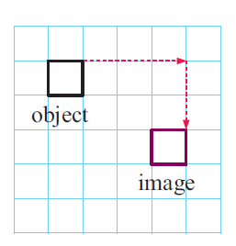
Daily review
TPS 35 seconds:
Translation is just a ________
Describe the movement of the square

Slide 4
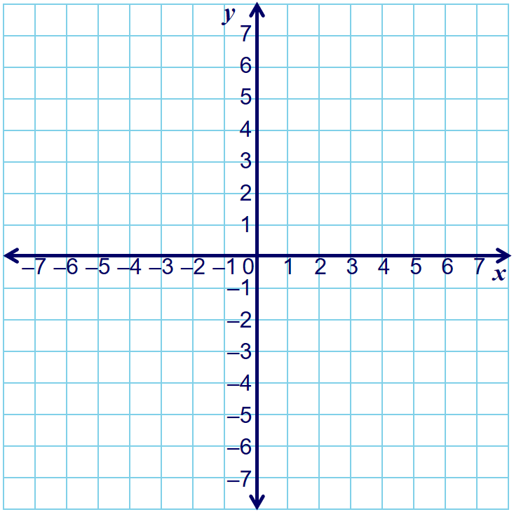

Which shows $90°$Clockwise?
A
A
B
B

Slide 5

Which does not show $180°$rotation?
A
A
B
B

Slide 6
Individual task
Exercise B (designing a logo) pg. 99 - 103.
(finish rotation work from yesterday)

Slide 7
Reflection is just a flip
Lines of symmetry are the centre lines of symmetrical shapes
The lines are also called mirror lines
Vertical lines of symmetry
Horizontal lines of symmetry
Reflection can also occur outside of an object.

Slide 8
Reflection
https://www.youtube.com/watch?v=j1X_UIOvEwA
(first 2 minutes)
Think: how does reflecting over the y axis change the x-coordinates?

Slide 9
Choral response
When reflecting shapes in a mirror line, each corner should be the same distance away from the mirror line on each side.
When reflecting shapes in a mirror line, each ______ should be the same distance away from the mirror line on each side.
When reflecting shapes in a mirror line, each ______ should be the ____ distance away from the mirror line on each side.
What should be the same distance away from the mirror line?

Slide 10
Question of the day
“When reflecting an object, each corner should be _______ from the mirror line?”
A: each corner should be the same distance from the mirror line

Slide 11
4
3
3
4
4
3
3
4

Slide 12
Reflect the blue triangle about the y axis THEN use the image and reflect about the x axis

Slide 13
Activity time
Complete the task sheet provided
Ask questions, get assistance and work well

Slide 14
Challenge (personal whiteboards)
Write your first name (or initials) in large block letters using grid paper.
Draw a mirror line 2 spaces under your name
Reflect your name over the mirror line
Example:

